Slide 1
Phishing using SEToolkit
Author Name:- Shashi Kant
Inspired by:- Souvik SIr
Date:- 27/12/2018
Now before starting let’s see what Phishing is--
Phishing is the fraudulent attempt to obtain sensitive information such as usernames, passwords and credit card details by disguising as a trustworthy entity in an electronic communication. Typically carried out by email spoofing or instant messaging, it often directs users to enter personal information at a fake website, the look and feel of which are identical to the legitimate site. Phishing is an example of social engineering techniques being used to deceive users. Users are often lured by communications purporting to be from trusted parties such as social web sites, auction sites, banks, online payment processors or IT administrators.

Slide 2
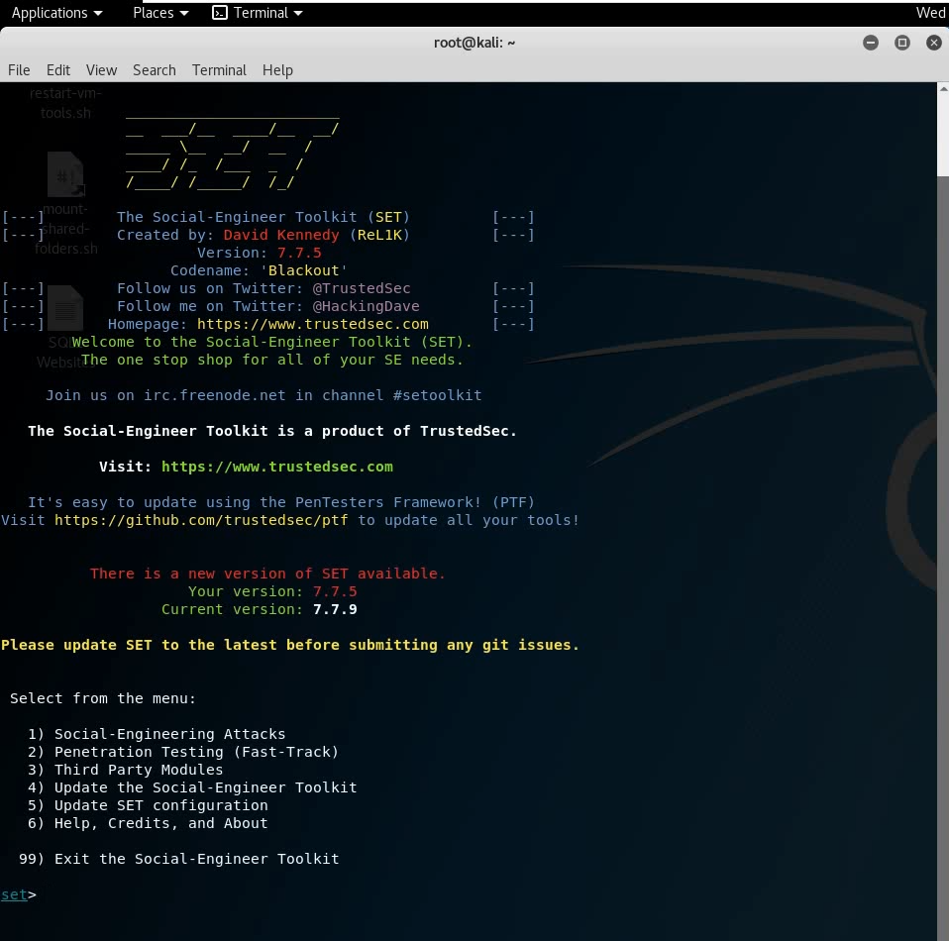
Step 1:
Open Linux Terminal and type SEToolkit to open Social Engineering Toolkit
Step 2:
For Phishing we need to select – 1
i.e. Social-Engineering Attacks.

Slide 3
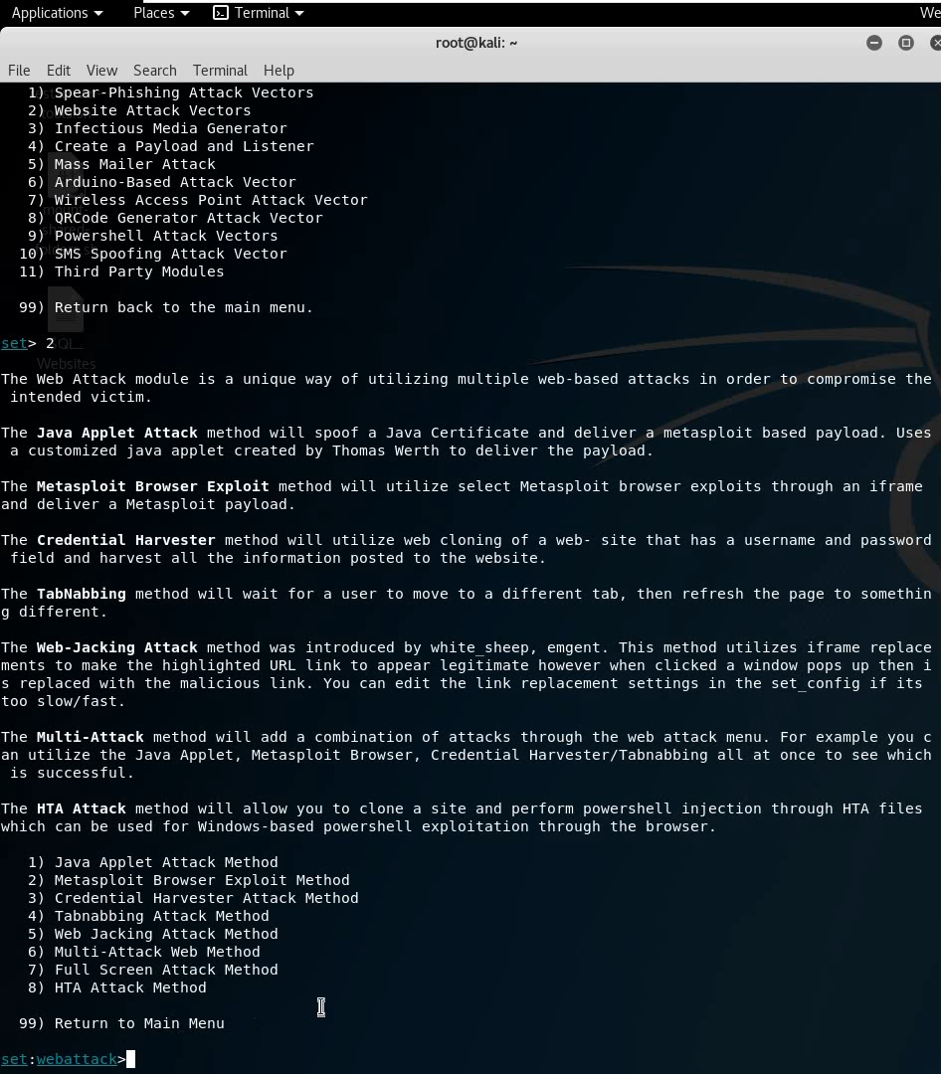
Step 3:
For phishing we need to select – 3
i.e. Credential Attack.

Slide 4
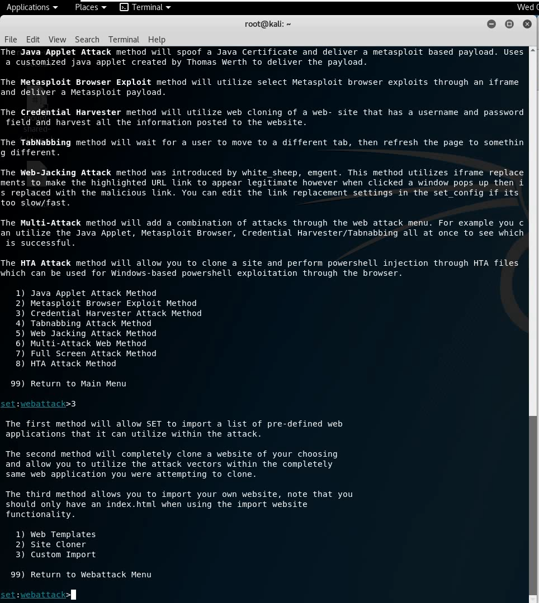
Step 4:
Now select – 2
i.e. Site Cloner

Slide 5
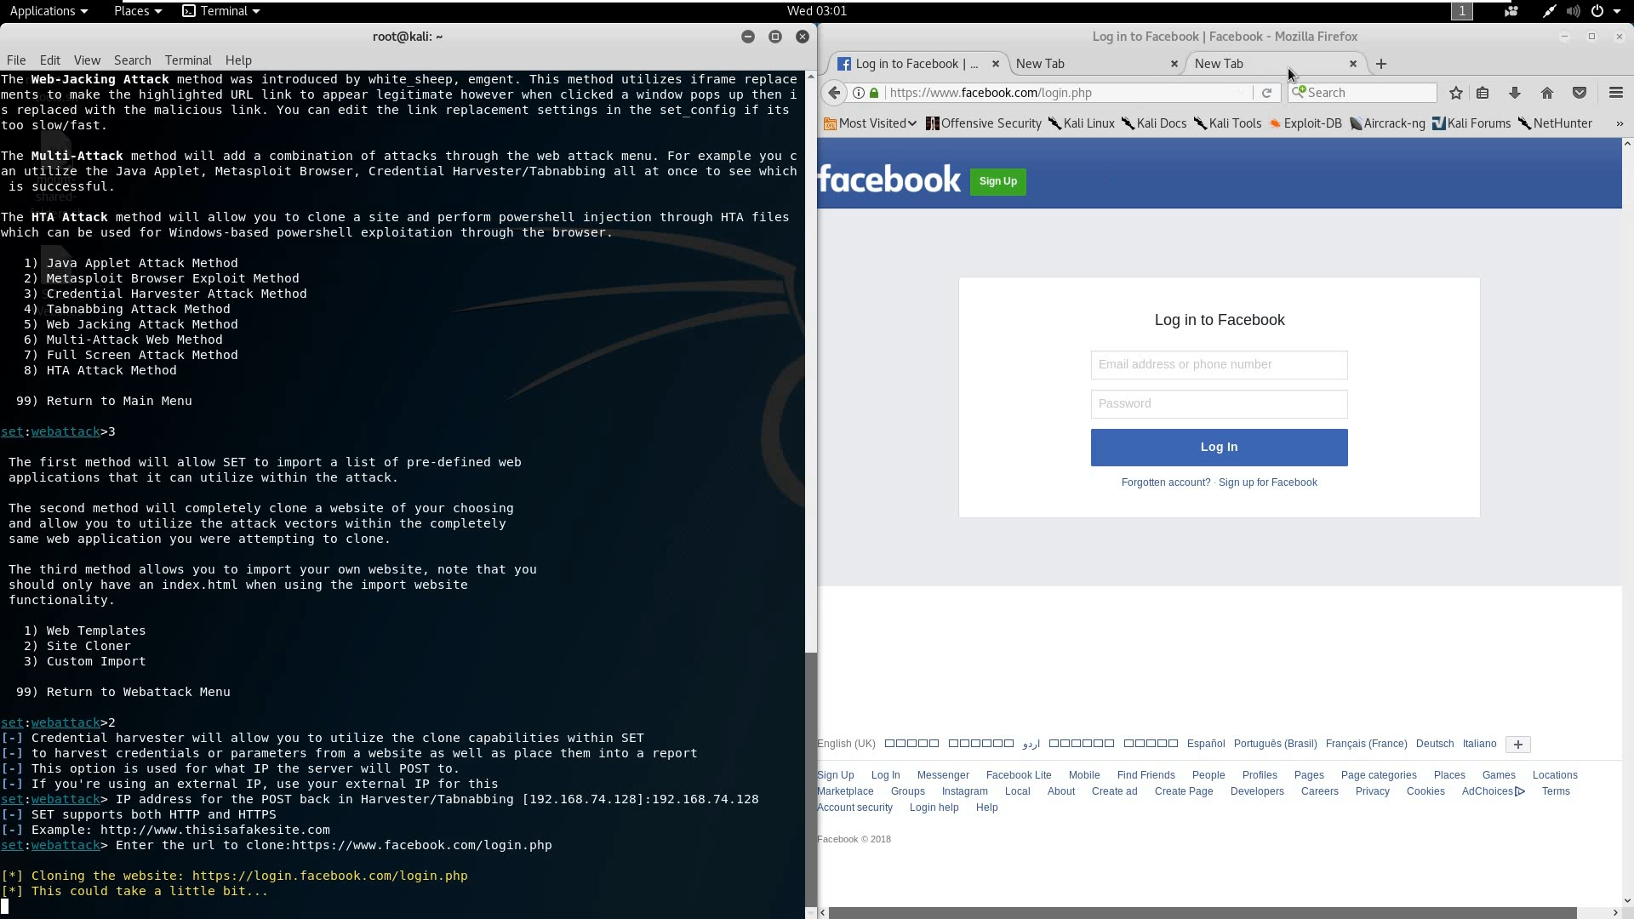
Step 5:
Now we need to provide our ip address.
After that now let’s clone a website. EG- https://facebook.com.

Slide 6
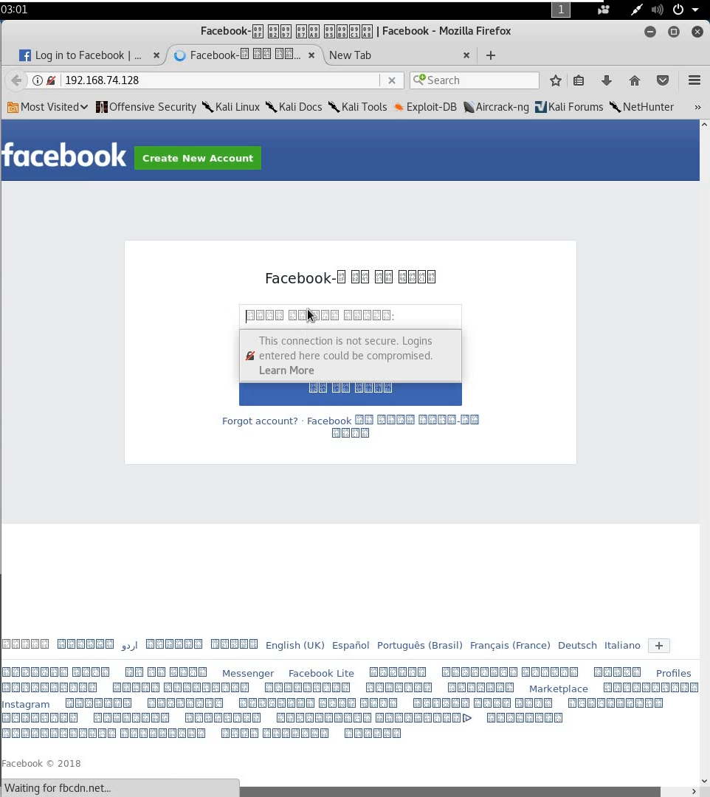
Step 6:
The website has been cloned to our ip address.
Now if we open our ip we would be rendered to the phishing page

Slide 7
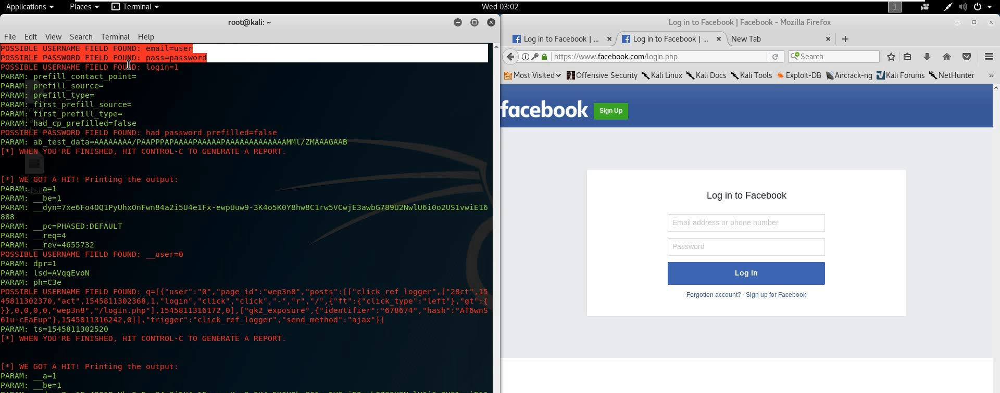
Step 7:
Now, if we type any credential information in the link provided, the information would be visible to us.

